Slide 1

Plugging into the future: an exploration of electricity consumption patterns.

Slide 2
Group leader name : p. Vinitha
Group members name :
K. Shakina banu
T. Resha
K. Thirsha

Slide 3
Project report
Introduction
Problem define
Result
Advantages & disadvantage
Application
Conclusion
Future scope

Slide 4
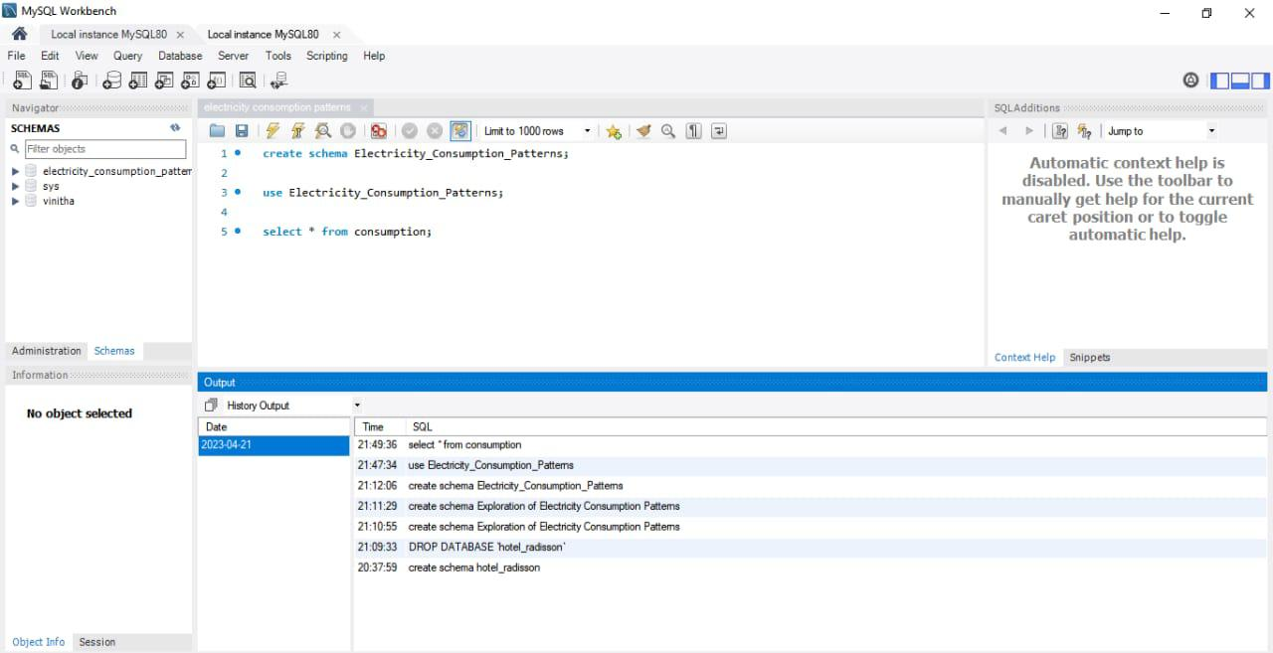

Slide 5
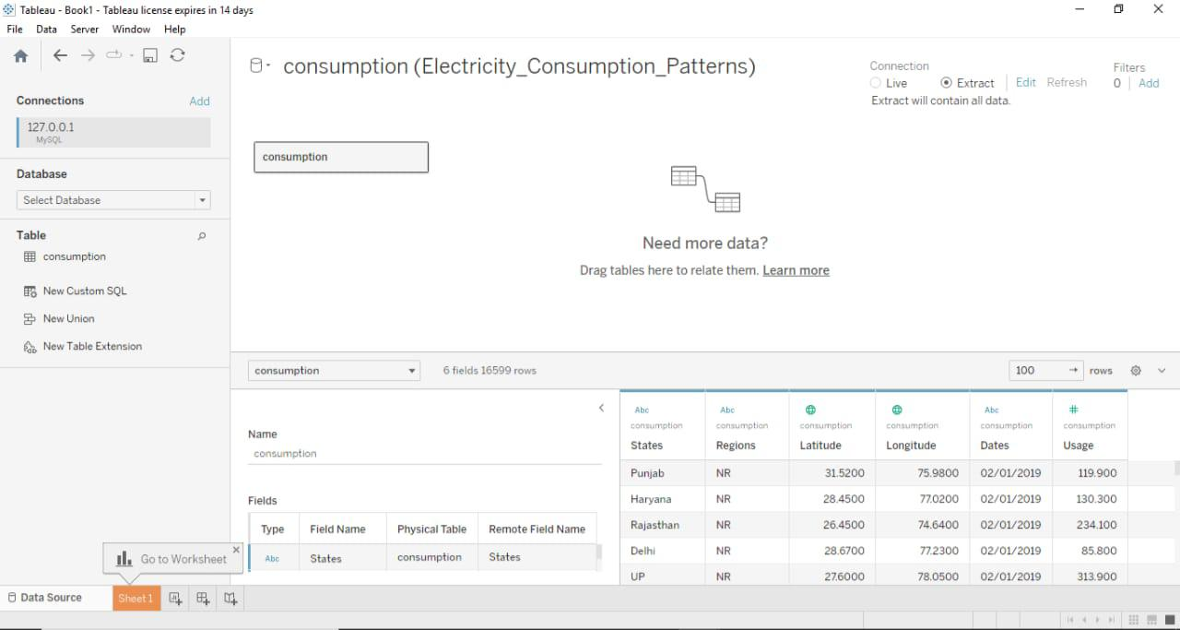

Slide 6
Thank you...

